Slide 1
Day 2

Slide 2
Introduction to Knime Analytics Platform

Slide 3
KNIME Analytics Platform is a free, open-source software for creating data science. It is helping you discover the potential hidden in your data, mine for fresh insights, or predict new features.
Knime has a friendly interface that is called KNIME Workbench with drag and drop nodes features.
You can manage your own knime project in the KNIME Workspace.
KNIME Workspace is a folder on the local computer to store KNIME workflows, node settings, and data produced by the workflow.
Each nodes have its own functionality for data science and ML purposes.
With knime, you can choose from data analysis to visualisation to build your own ML/DL project with codeless and low code style.

Slide 4
KNIME Fundamental

Slide 5
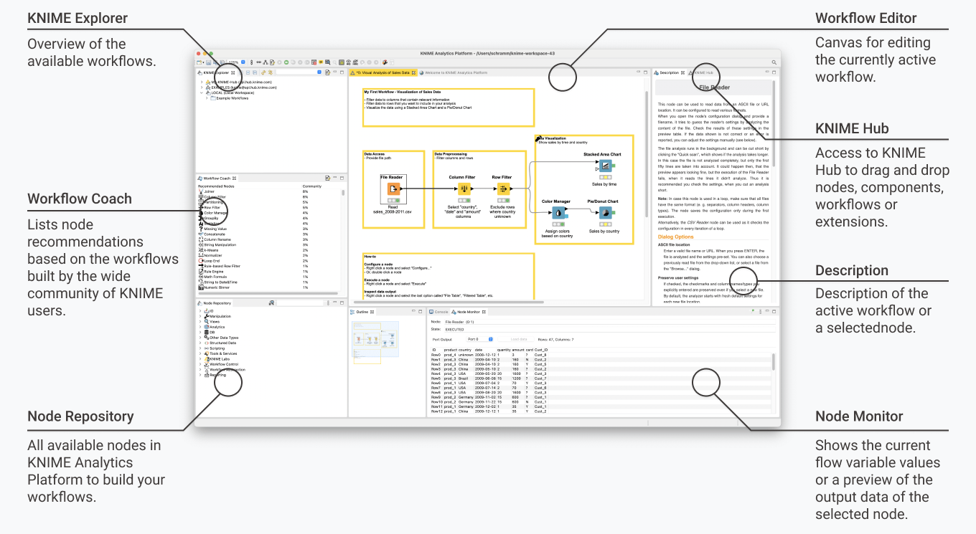
KNIME WORKBENCH

Slide 6
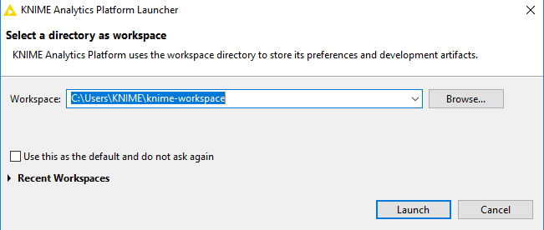
KNIME WORKSPACE
Every time you launch Knime Analytics Platform, a dialog will pop up. You can create more than one workspace to store all the KNIME Workflows

Slide 7
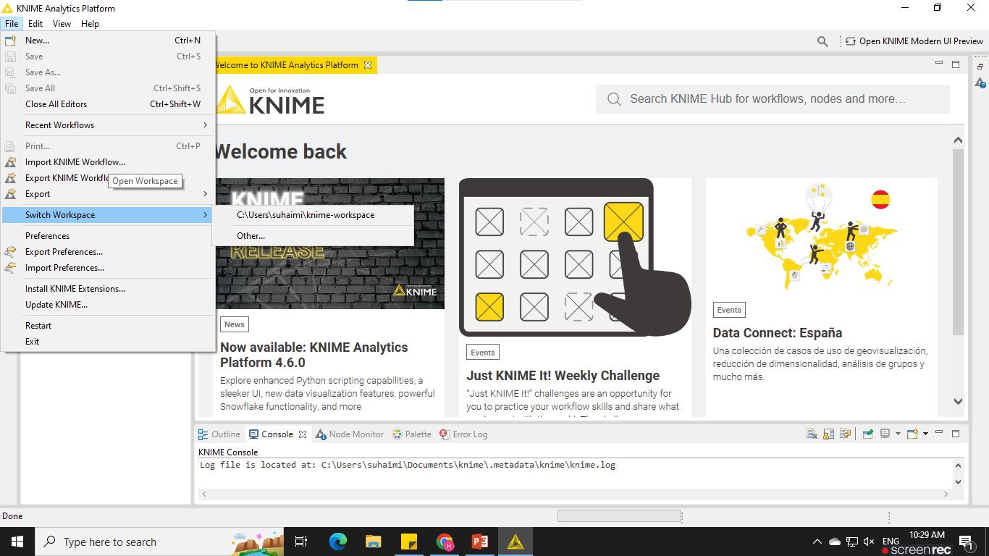
KNIME WORKSPACE
You can switch between the KNIME workspace at File and select Switch Workspace

Slide 8
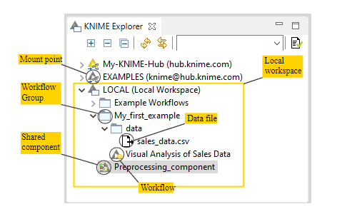
KNIME Explorer
The KNIME Explorer is where you can manage workflows, workflow groups, and server connections.
By default only the local workspace, the EXAMPLES server and the link to connect to your personal KNIME Hub space are visible in the KNIME Explorer.

Slide 9
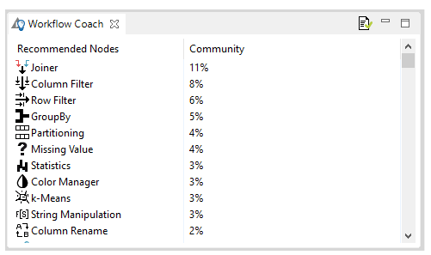
WORKFLOW COACH
The Workflow Coach provides node recommendations.
If a node is selected in the workflow editor, the workflow coach shows the most popular nodes to follow the selected node.
Otherwise, the recommendations represent the most popular nodes to start a workflow.

Slide 10
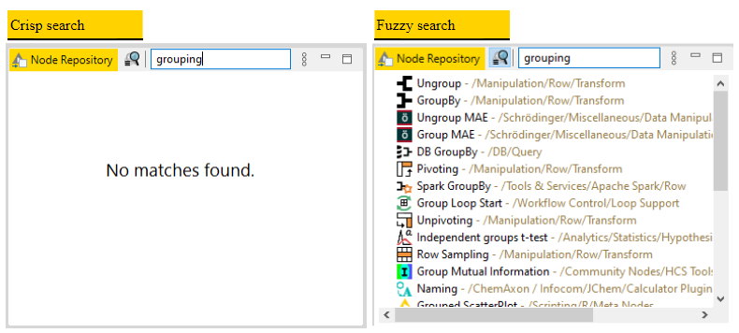
NODE REPOSITORY
Currently installed nodes are available in the Node Repository where they are organized under different categories.
Search for a node by expanding the categories or by typing a search term in the search field on top of the node repository, as shown in figure below.

Slide 11
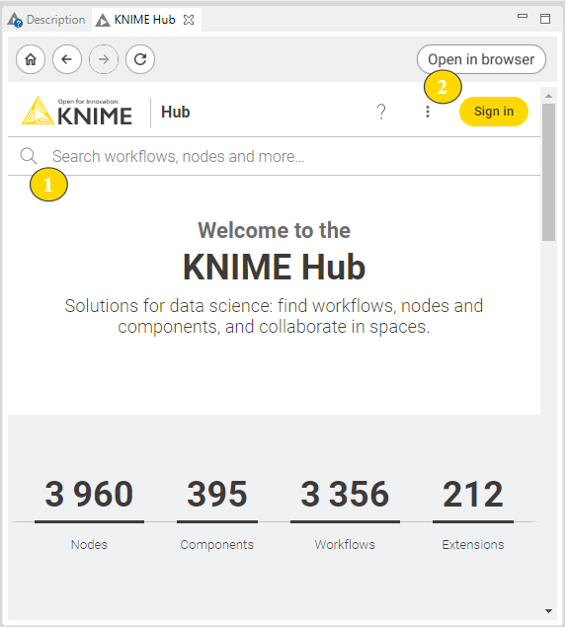
KNIME Hub View
KNIME Hub is a platform where KNIME community share their nodes, extensions, components, and workflows.

Slide 12
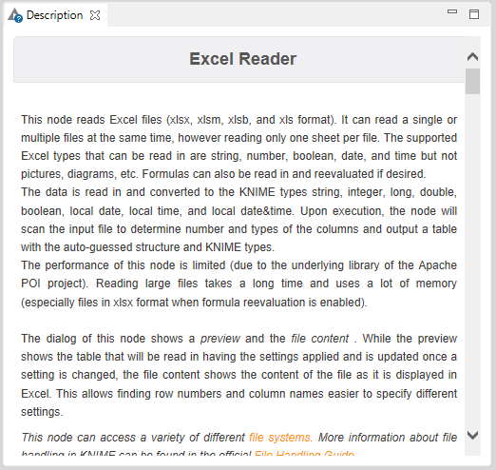
DESCRIPTION
The Description panel on the right of the KNIME Workbench shown in figure below provides a description of the currently active workflow, or a node selected in the node repository or workflow editor.

Slide 13
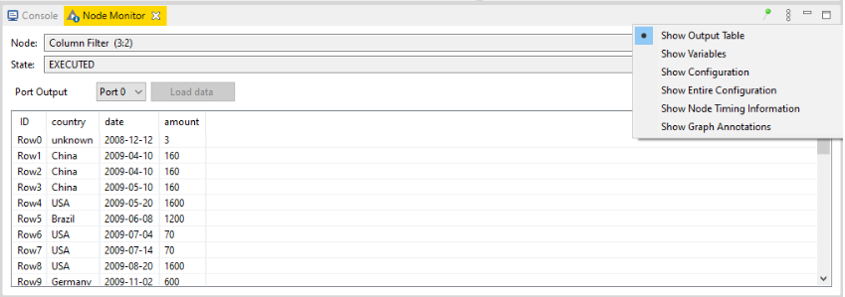
NODE MONITOR
The Node Monitor tab is located on the same panel of the console tab on the bottom part of the KNIME Workbench shown in figure below.
It is especially useful to inspect intermediate output tables in the workflow.

Slide 14
OUTLINE
CONSOLE
In the Outline, on the bottom part of the KNIME Workbench shown in Figure below, you find an overview of the currently active workflow.
If the whole workflow does not fit in the workflow editor, you can change the active area by scrolling the blue, transparent rectangle.
The Console tab on the bottom part of the KNIME Workbench shown in Figure below shows all warning and error messages related to the workflow execution.
To debug and log information messages to be reported in the console, change the console log level in File → Preferences → KNIME → KNIME GUI.

Slide 15
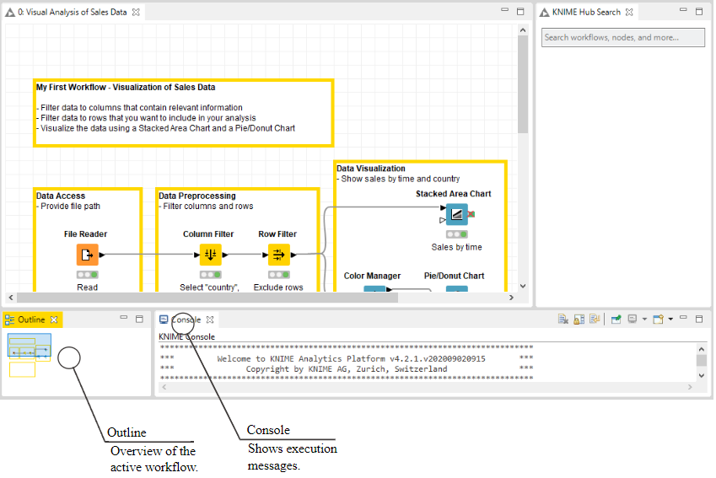

Slide 16
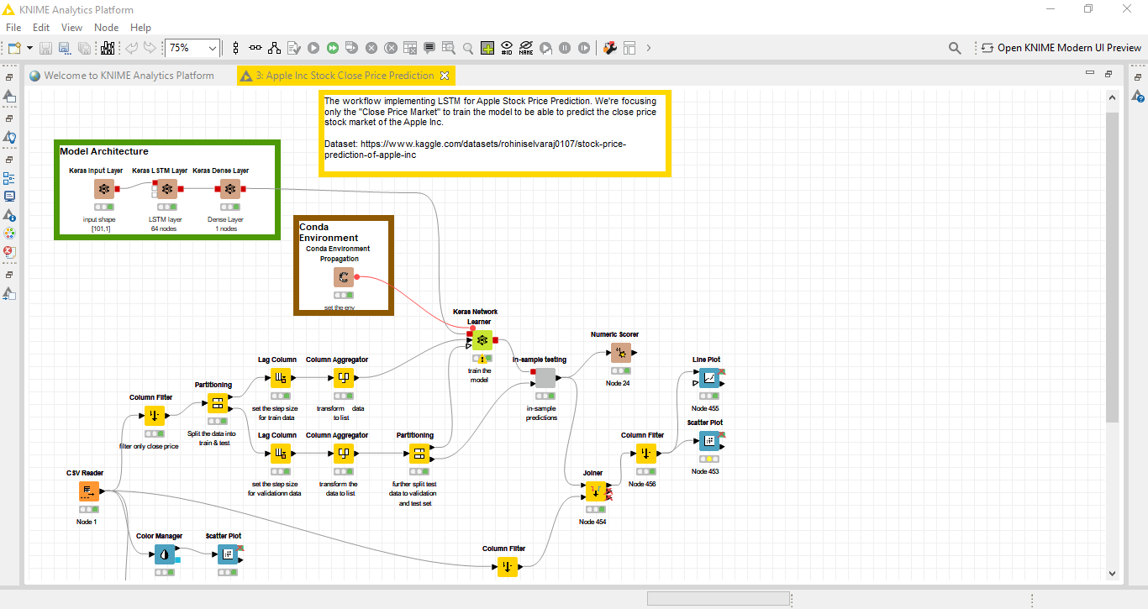
KNIME WORKFLOW
KNIME Workflow is where all your nodes represented with its own individual tasks.
Example of KNIME Workflow for Apple Stock Price Prediction

Slide 17
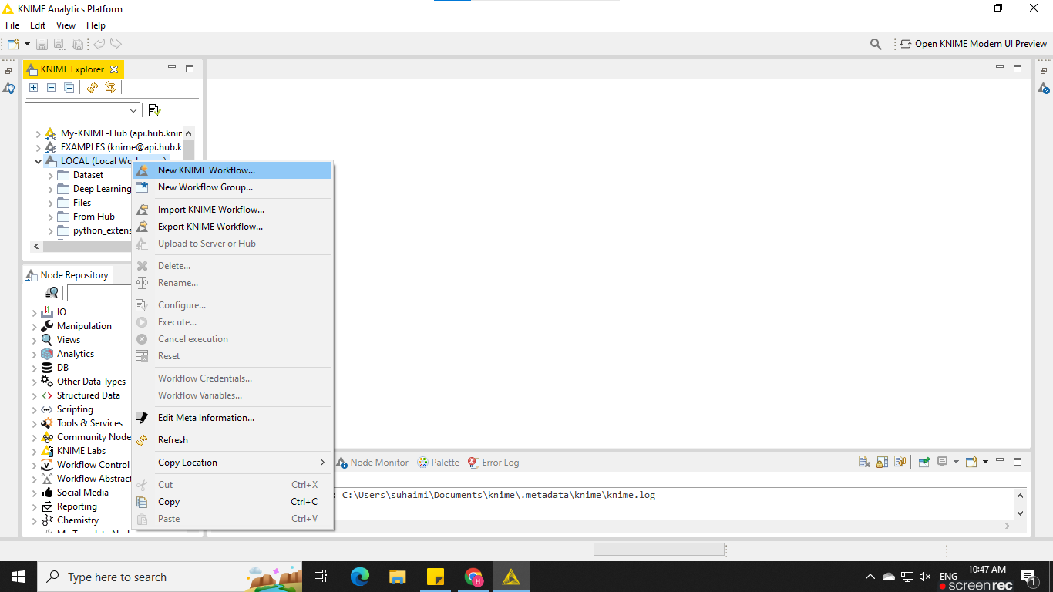
WORKFLOW EDITOR
Workflow Editor is where you create and assemble your nodes
You can create new KNIME Workflow and Workflow Group by right-click to LOCAL(Local Workspace)

Slide 18
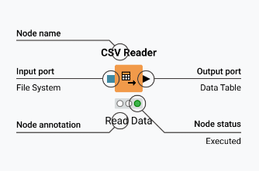
NODES
In KNIME Analytics Platform, individual tasks are represented by Nodes.
Nodes can perform all sorts of tasks, including reading/writing files, transforming data, training models, creating visualizations, and so on.

Slide 19
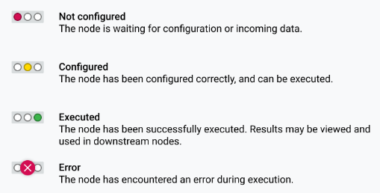
NODES - Status
Node status can be represented as the traffic light in the figure below.

Slide 20
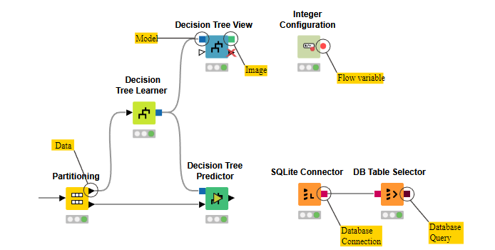
NODE - Input and Output Ports
A node may have multiple input ports and multiple output ports.
The input ports consume the data from the output ports of the predecessor nodes, and the output ports provide data to the successor nodes in the workflow.
An output port can only be connected to an input port of the same type - data to data, model to model, and so on.

Slide 21
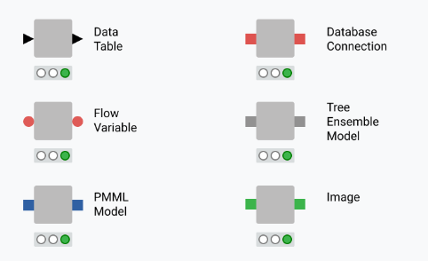
NODES - Input and Output Ports
The input(s) are the data that the node processes via the node ports, and the output(s) are the resulting data. Each node has specific settings, which you can adjust in a configuration dialog.

Slide 22
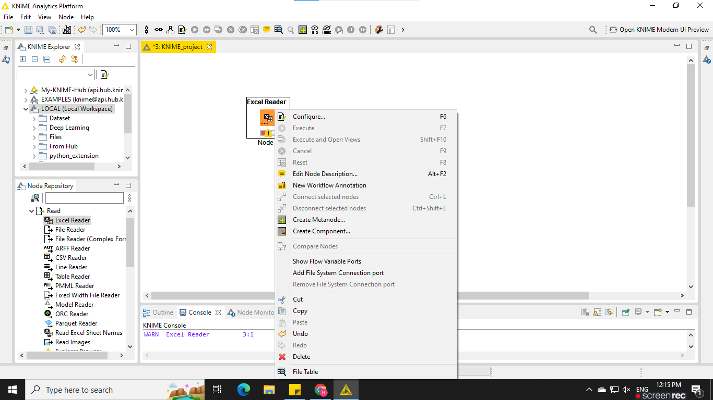
NODE - Configuration
Nodes can be configured by adjusting the setting in its configuration.
To configure the setting, right-click to the node and select configure.
To stop the executing nodes, right-click the node and select cancel
To reset a node right-click then node and select reset

Slide 23

COMPONENT
Component are KNIME nodes that you create with a KNIME workflow.
They encapsulate and abstract functionality, can have their own dialog, and can have their own sophisticated, interactive views.
Components can be reused in your own workflows and shared with others: via KNIME Server or KNIME Hub.
They can also represent web pages in an analytical application deployed to others via KNIME Server.

Slide 24

METANODE
Metanodes allow you to organize your workflows better: you can take part of a larger workflow and collapse it into a gray box that hides that part of the workflow’s functionality.
It also makes it easier for others to understand what your workflow does as you can structure it a bit more hierarchically.

Slide 25
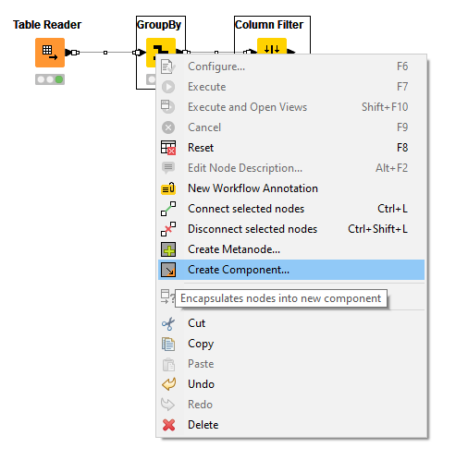
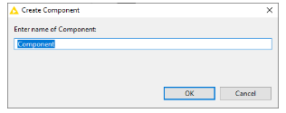
Creating Component and Metanode
Select the nodes you wish to create as component or metanode.
Right-click to the selected node and select Create Metanode../Component..
name the component/metanode

Slide 26
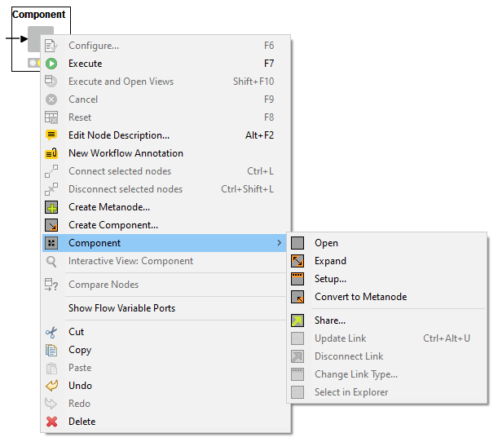
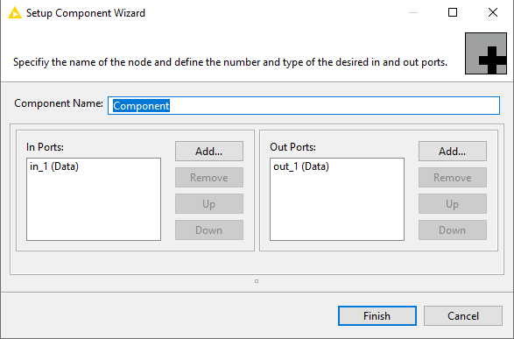

Configure Components and Metanodes
Drop-down to select port type

Slide 27
KNIME Extensions and Integrations

Slide 28
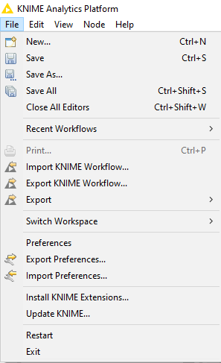
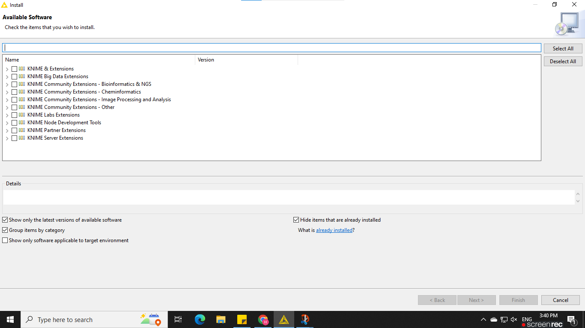
Extensions and Integrations provide additional functionality such as access to and processing of complex data types, as well as the use of advanced algorithms.
You can download and install KNIME Extensions and Integrations to your local machine depending on your project uses.
All Extension and Integration provided by KNIME

Slide 29
KNIME Deep Learning Fundamentals

Slide 30
KNIME Deep Learning - Getting Started
As we learned in KNIME Installation section before, to run a deep learning we need to install the require Deep Learning KNIME Extension. I believe you’ve done so.
Make sure you have configured your conda environment in Python Deep Learning. Go to FILE, select PREFERENCES and PYTHON DEEP LEARNING.
For this particular Time Series Analysis, the essential KNIME extension to be used is KERAS Integration. Make sure you have installed keras integration in your KNIME platform.
Tensorflow Integration also can also be used for TSA but require coding.
For this particular module, we will make use of Keras Integration to maximize the codeless advantage the platform offers to the users.

Slide 31
Deep Learning Essential Nodes
The extension contains the following nodes:
The DL Network Executor node for executing deep neural networks.
The DL Keras Network Reader node to read in pre-defined, potentially trained, Keras networks.
The DL Keras Network Learner node for training or fine-tuning deep neural networks within KNIME via Keras.
A set of nodes for flexibly creating, editing, executing, and training deep neural networks with user-supplied Python scripts.
More than sixty layer nodes you can use to set up your own deep network architecture without writing a single line of code (since version 3.6.0).
Nodes can be found in the Node Repository (Analytics > Integrations > Deep Learning)

Slide 32
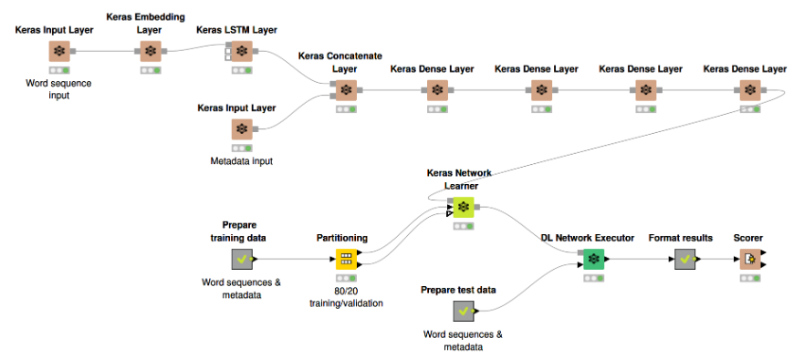
Example of Deep Learning Workflow using Keras Integration

Slide 33
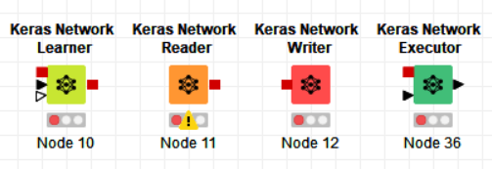
Keras DL Node Group
Keras Network Learner:This node performs supervised learning on a Keras deep learning network.
Keras Network Reader:This node reads a Keras deep learning network from an input file.The file can either contain a full, pre-trained network (.h5 file) or just a network specification without weights (.json or .yaml file).

Slide 34
Keras DL Node Group
Keras Network Writer: Writes a Keras network to a file.
Keras Network Executor: This node executes a Keras deep learning network on a compatible external back end that can be selected by the user.

Slide 35
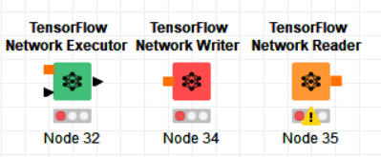
TensorFlow DL Node Group
TensorFlow Network Executor: This node executes a TensorFlow deep learning network on a compatible external back end that can be selected by the user.
TensorFlow Network Writer:Writes a TensorFlow network to a file or directory.
TensorFlow Network Reader: This node reads a TensorFlow deep learning network from a directory or zip file.

Slide 36
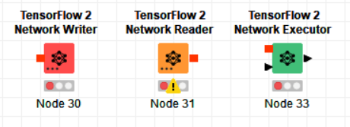
TensorFlow 2 DL Node Group
TensorFlow 2 Network Writer:Writes a TensorFlow 2 network to a file or directory.
TensorFlow 2 Network Reader: This node reads a TensorFlow 2 model from a file or folder.
TensorFlow 2 Network Executor: This node executes a TensorFlow 2 deep learning network.

Slide 37
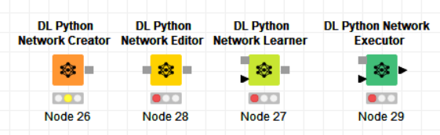
Python DL Node Group
DL Python Network Creator: This node allows custom creation of a (Python compatible)deep learning network in a local Python installation via a user-defined script.The path to the Python executable has to be configured in Preferences → KNIME → Python. It also allows to import Jupyter notebooks as Python modules via the knime_jupyter module that is part of the Python workspace.

Slide 38
Python DL Node Group
DL Python Network Editor: This node allows custom editing of a (Python compatible)deep learning network in a local Python installation via a user-defined script.
DL Python Network Learner: This node allows custom training and fine-tuning/transfer learning of a (Python compatible) deep learning network in a local Python installation via a user-defined script.

Slide 39
Python DL Node Group
DL Python Network Executor: This node allows custom execution of a (Python compatible)deep learning network in a local Python installation via a user-defined script.

Slide 40
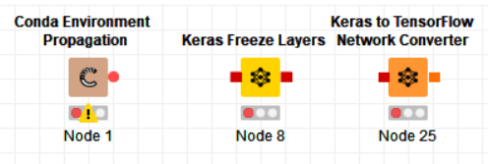
Miscellaneous DL Node Group
Conda Environment Propagation: This node ensures the existence of a specific configurable Conda environment and propagates the environment to Python, R, or other Conda-aware downstream nodes. This is useful to make workflows that contain Conda-aware nodes more portable by allowing to recreate the Conda environment used on the source machine on the target machine.

Slide 41
Miscellaneous DL Node Group
Keras Freeze Layers: Freezes the parameters of the selected layers. If the model is trained afterwards, the parameters of the selected layers are not updated. All other layers are set to trainable.

Slide 42
Miscellaneous DL Node Group
Keras to TensorFlow Network Converter: Converts a Keras deep learning model with TensorFlow backend toa TensorFlow model. TensorFlow models can be executed using the TensorFlow Java API which is usually faster then using a Python kernel to execute the model via the Keras Python API.

Slide 43
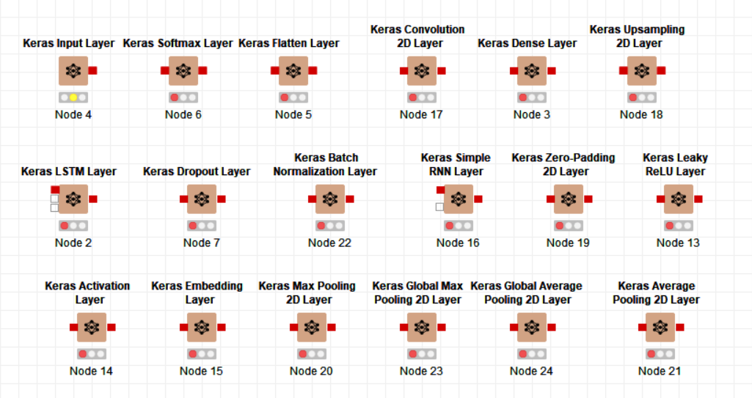
Neural Network Layers Node Group

Slide 44
References
KNIME Getting Started Guide
KNIME Workbench Guide
KNIME Components Guide
KNIME Deep Learning - Keras Integration

Slide 45
Other Useful Reference
KNIME Extensions Documentation
KNIME Integrations Documentation
KNIME Hub User Guide
KNIME Analytics Platform Documentation

